Slide 1

Week 2
Behram Khan

Slide 2

Game objects and Transform

Slide 3
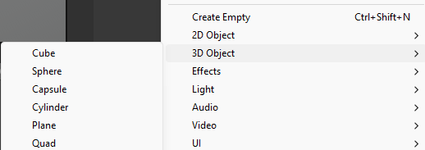
GameObjects
A GameObject is the fundamental building block of everything in Unity. GameObjects are containers of components.
Everything you see in a Unity scene is a GameObject:
When we make a new gameobject, it's added to the current scene.
A GameObject by itself is just a container. It does nothing until you attach components to it.
Every game object has a Transform component.
Notes:
STR: Store a value to memory.
ADD: Add two values.
SUB: Subtract one value from another.
MOV: Move data from one location to another.

Slide 4
GameObjects
They organize everything in a scene
They hold components
They allow hierarchy (parent-child)
They can be enabled/disabled
They can be created or destroyed at runtime
Notes:
STR: Store a value to memory.
ADD: Add two values.
SUB: Subtract one value from another.
MOV: Move data from one location to another.

Slide 5

Transform
Every GameObject has a Transform component.
It represents its location, position and scale in 2d or 3d space.
It contains a Vector that represents 3 float values.
Transform Gizmos: The visual representation in Scene view
Move (W), Rotate (E), Scale (R)
Axes:
🔴 Red → X (Left / Right)
🟢 Green → Y (Up / Down)
🔵 Blue → Z (Forward / Backward)
Notes:
STR: Store a value to memory.
ADD: Add two values.
SUB: Subtract one value from another.
MOV: Move data from one location to another.

Slide 6
Physics

Slide 7
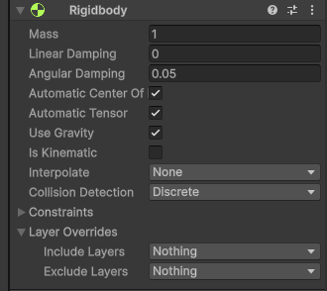
RigidBody
A Rigidbody is a component that allows a GameObject to interact with Unity’s physics system.
Without Rigidbody:
The object does NOT respond to gravity, It does NOT react to forces, It behaves like a static object
When you add Rigidbody:
Gravity affects the object
It can collide physically
It can receive forces
It has mass
It can have velocity
Notes:
STR: Store a value to memory.
ADD: Add two values.
SUB: Subtract one value from another.
MOV: Move data from one location to another.

Slide 8
Rigidbody Properties
Mass
How heavy the object is.
Higher mass = harder to move
Lower mass = easier to push
Use Gravity
If enabled → object falls.
Freeze Constraints
Used to prevent unwanted movement or rotation.
Example:
Freeze X and Z rotation for player
Prevent character from tipping over
Notes:
STR: Store a value to memory.
ADD: Add two values.
SUB: Subtract one value from another.
MOV: Move data from one location to another.

Slide 9
AddForce
Applies a physics-based force to a Rigidbody, allowing realistic motion like jumps, explosions, or pushes.
Syntax : rb.AddForce(Vector3 direction * magnitude, ForceMode mode);
Vector3 direction – the direction of the force (e.g., Vector3.up for jump)
magnitude – the strength of the force
ForceMode – type of force application:ForceMode.Force (continuous force, affected by mass)
ForceMode.Impulse (instant force, good for jumps)
Works with Rigidbody physics for collisions
Notes:
STR: Store a value to memory.
ADD: Add two values.
SUB: Subtract one value from another.
MOV: Move data from one location to another.

Slide 10
Colliders

Slide 11
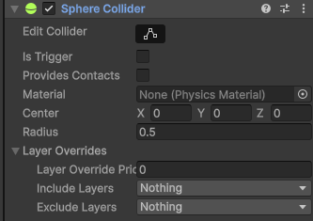
Collider
A collider defines the physical boundary of an object.
Unity has different type of colliders for us to use: Box, Sphere, Capsule, Mesh colliders and more.
If two colliders touch then collision happens.
At least one object must have a Rigidbody for collision events.
Notes:
STR: Store a value to memory.
ADD: Add two values.
SUB: Subtract one value from another.
MOV: Move data from one location to another.

Slide 12
Collider Shape & Size
Center: moves collider relative to object
Size / Radius : changes boundary size
Collider shape does NOT have to match mesh/visual exactly.
Mesh are visuals and collider is the physical boundary of the object.
You can:
Make hitbox bigger
Make hitbox smaller
Offset it for gameplay reasons
Hitbox : colliders is games are also known as hitbox.
Notes:
STR: Store a value to memory.
ADD: Add two values.
SUB: Subtract one value from another.
MOV: Move data from one location to another.

Slide 13
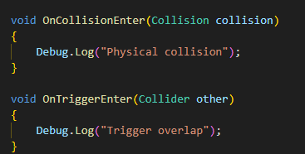
Collision vs Trigger
Normal Collider:
Blocks movement
Physics reaction happens
Trigger Collider (Is Trigger checked):
No physical blocking
Detects overlap only
Used to check if something has entered in an area without doing anything else
Notes:
STR: Store a value to memory.
ADD: Add two values.
SUB: Subtract one value from another.
MOV: Move data from one location to another.

Slide 14
Physics Material
Physics Material controls:
Friction
Bounciness
High friction → stops quickly
Low friction → slides
High bounciness → rebounds
Notes:
STR: Store a value to memory.
ADD: Add two values.
SUB: Subtract one value from another.
MOV: Move data from one location to another.

Slide 15
Rigidbody & Collision Rules
For collision to work:
Both objects need Collider
At least one must have Rigidbody
If both have Rigidbody:
One may need constraints or set platform as static (no Rigidbody)
Notes:
STR: Store a value to memory.
ADD: Add two values.
SUB: Subtract one value from another.
MOV: Move data from one location to another.

Slide 16
Script and Movement

Slide 17
Creating a Script
Scripts allow us to add custom behavior to our Game Objects.
Attach script to a Game Object by:
Dragging onto object OR Add Component → Select script
Script name’s first letter should be capital and must inherit Monobehavior to be added to a game object in scene.
Notes:
STR: Store a value to memory.
ADD: Add two values.
SUB: Subtract one value from another.
MOV: Move data from one location to another.

Slide 18
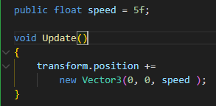
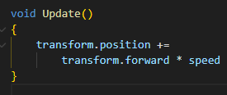
Moving an Object
To move an object, we need to tell it a direction to move in and speed.
What this does:
• Moves object on Z axis
transform.forward is the forward-facing (blue) vector of the game object.
Note : It changes the object's Transform position directly, without using physics.
Notes:
STR: Store a value to memory.
ADD: Add two values.
SUB: Subtract one value from another.
MOV: Move data from one location to another.

Slide 19

Using Translate()
What this does:
• Moves relative to object’s local space
It changes the object's Transform position directly, without using physics.
This means:
Move forward
At speed 5 units per second
Notes:
STR: Store a value to memory.
ADD: Add two values.
SUB: Subtract one value from another.
MOV: Move data from one location to another.

Slide 20
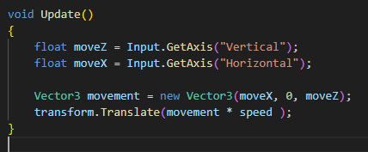
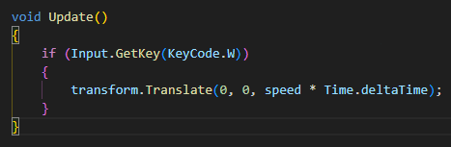
Moving using Input
Simply wrap the movement functions in input statements in update.
Notes:
STR: Store a value to memory.
ADD: Add two values.
SUB: Subtract one value from another.
MOV: Move data from one location to another.

Slide 21
Material

Slide 22
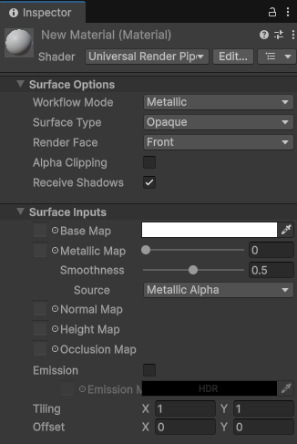
Material
A Material defines how an object looks.
It controls:
Color
Texture
Smoothness
Metallic effect
Transparency
Interaction with light
Material does NOT define shape.
It defines appearance.
Notes:
STR: Store a value to memory.
ADD: Add two values.
SUB: Subtract one value from another.
MOV: Move data from one location to another.

Slide 23
Material Color
Every material has a Base Color.
You can:
Change RGB values
Pick custom color
Make it darker or lighter
Example:
Red cube
Blue platform
Gold coin
Notes:
STR: Store a value to memory.
ADD: Add two values.
SUB: Subtract one value from another.
MOV: Move data from one location to another.

Slide 24
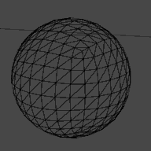

Mesh Filter
Mesh Filter defines the shape of the 3D object.
Examples of Mesh:
Cube
Sphere
Cylinder
Custom model
You can change shape by changing the Mesh in the Mesh Filter.
Notes:
STR: Store a value to memory.
ADD: Add two values.
SUB: Subtract one value from another.
MOV: Move data from one location to another.

Slide 25
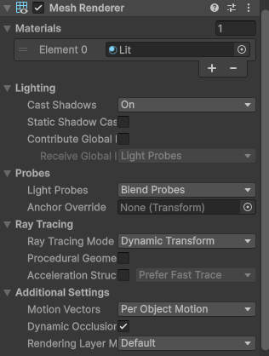
Mesh Renderer
Mesh Renderer tells Unity:
“Draw this object on the screen.”
It:
Renders the mesh
Applies material to the mesh
Interacts with lighting
Without Mesh Renderer:
Object exists
But is invisible
Notes:
STR: Store a value to memory.
ADD: Add two values.
SUB: Subtract one value from another.
MOV: Move data from one location to another.

Slide 26
Tag

Slide 27

Tag
A Tag is a string label assigned to a GameObject to categorize or identify it. Tags are especially useful in scripts for detecting specific objects, like obstacles, enemies, or collectible items.
Detect collisions with specific types of objects.
Simplifies code instead of checking object names.
Easy to change categories without renaming objects.
Can help manage large scenes with many objects.
It can be assigned by selecting the game object and in Hierarchy assigning or creating a new tag from the Tag dropdown menu.
Notes:
STR: Store a value to memory.
ADD: Add two values.
SUB: Subtract one value from another.
MOV: Move data from one location to another.

Slide 28
Prefab

Slide 29
Prefab
A Prefab is a reusable GameObject stored as an asset. Prefabs allow you to create multiple instances of the same object in your scene or at runtime.
You can instantiate copies at runtime.
Advantages:
Edit once, apply changes to all instances.
Can override changes for specific instances.
Supports nesting, so a Prefab can have child Prefabs.
Ideal for spawning enemies, coins, obstacles, or power-ups dynamically.
Notes:
STR: Store a value to memory.
ADD: Add two values.
SUB: Subtract one value from another.
MOV: Move data from one location to another.

Slide 30
Parent and Child Relation

Slide 31
Parent and Child Relation
Unity allows GameObjects to be hierarchically organized. A GameObject can be a parent with one or more children.
How to set up: Drag a GameObject onto another in the Hierarchy.
At runtime: childObject.transform.parent = parentObject.transform;
Moving, rotating, or scaling the parent affects all children.
Example: If the player moves and the camera is a child of the player, the camera automatically follows.
Useful for creating grouped objects like vehicles, characters with weapons, UI panels, etc.
Notes:
STR: Store a value to memory.
ADD: Add two values.
SUB: Subtract one value from another.
MOV: Move data from one location to another.

Slide 32
GetComponent
GetComponent allows scripts to access other components attached to a GameObject.
Syntax : Rigidbody rb = GetComponent<Rigidbody>();
Typically done in Awake() or Start() to reduce overhead in Update()
Ensures references are ready before game logic runs
Notes:
STR: Store a value to memory.
ADD: Add two values.
SUB: Subtract one value from another.
MOV: Move data from one location to another.

Slide 33
FixedUpdate vs Update
Called at fixed intervals. Ideal for physics calculations and Rigidbody movement.
Update():
Called every frame
Frame rate dependent
Best for input checks, animations, UI updates
FixedUpdate():
Called at fixed intervals (not frame rate dependent)
0.02 seconds (50 times per second) by default
Used for physics calculations like Rigidbody movement
Ensures consistent physics behavior across different frame rates
Notes:
STR: Store a value to memory.
ADD: Add two values.
SUB: Subtract one value from another.
MOV: Move data from one location to another.

Slide 34


